Slide 1
STUDENT FINANCE OVERVIEW
ACADEMIC YEAR 2022/23
Wigan & Leigh College
29th March 2022

Slide 2
i
STUDENT FINANCE OVERVIEW
PRESENTATION CONTENTS
This presentation will give potential new undergraduate students from England an
overview of the fundamental key messages needed to understand student finance:
Section 1 – What support can you get?
Section 2 – How do you get it?
Section 3 – When and how do you repay it?
Section 4 – Budgeting and Key Messages

Slide 3
STUDENT FINANCE ENGLAND
AN INTRODUCTION
Student Finance England provide financial support on behalf of the UK government
to eligible students from England entering higher education in the UK:
Two main costs you will have while studying are tuition fees and living costs
SFE make finance available to help students with both
You may be able to get a range of financial help and support, depending on;
Your course and where you live and study
Your household income
Your personal circumstances

Slide 4
i
STUDENT FINANCE ENGLAND
GENERAL ELIGIBILITY
Students need to meet certain residency criteria in order to be eligible for financial
support from SFE:
Have settled status – Can live in the UK without any Home Office restriction
Be ordinarily resident in England on the first day of the first academic year of
their course
Been living in the UK for the three years immediately prior to this date
You may also be eligible to apply for SFE support if you have a residency status such as Refugee, Stateless or Humanitarian Protection
Go to www.gov.uk/student-finance/who-qualifies for more information
i
From AY 21/22, rules for EU/EEA nationals studying in the UK changed
www.gov.uk/guidance/studying-in-the-uk-guidance-for-eu-students
Notes:
Exceptions
If the student, their spouse, civil partner, parent/stepparent are recognised by the Government as a refugee and lived in this country since this status was awarded.
If the student, their spouse, civil partner, parent/stepparent, have been granted Humanitarian Protection to stay in the UK by the Home Office, resulting from a failed asylum application.
Long Residency Rule
The long residency regulation extends eligibility for student finance out to students who qualify under and can evidence one of the following criteria:
Applicants aged under 18 years of age are required to have lived in the UK for at least 7 years
Applicants aged 18 years and above are required to have either spent at least half their life in the UK or at least 20 years in the UK
This needs to include three years’ lawful ordinary residence before the first day of the first academic year of the course for all such applicants

Slide 5
STUDENT FINANCE OVERVIEW
WHAT SUPPORT COULD YOU GET?
ACADEMIC YEAR 2022/23

Slide 6

STUDENT FINANCE 2022/23
THE STUDENT FINANCE PACKAGE
MAINTENANCE
LOAN
#2
APPLY
TUITION FEE
LOAN
EXTRA
SUPPORT
#1

Slide 7
STUDENT FINANCE 2022/23
TUITION FEES AND LOANS
For academic year 2022/23, Approved (Fee Cap) Higher Education providers can
charge full-time students tuition fees of up to £9,250*:
With tuition fees of up to £9,250, can you afford to study in higher education?
Eligible students won’t have to pay any tuition fees up front
A Tuition Fee Loan is available to cover the fee* charged by a provider
Or up to £6,165 is available for courses at ‘Approved’ HE providers
A Tuition Fee Loan doesn’t depend on household income
SFE pay a Tuition Fee Loan directly to your university or college
i
*Up to £11,100 for Accelerated Degree courses at Approved (Fee Cap)
providers with OfS Access/Participation Plan and TEF award

Slide 8
STUDENT FINANCE 2022/23
THE STUDENT FINANCE PACKAGE
MAINTENANCE
LOAN
EXTRA
SUPPORT
TUITION FEE
LOAN
#1

Slide 9
STUDENT FINANCE 2022/23
MAINTENANCE (LIVING COST) LOANS
So that’s tuition fee’s covered, but what other support can you get?
A Maintenance Loan is available to help students with their living costs:
All eligible students are entitled to get some Maintenance Loan support
The actual amount you can get depends on your household income and where you live and study
Your Maintenance Loan is paid directly into your bank account each term
Tuition Fee and Maintenance Loans do have to be repaid but not until you’ve
left university/college and your income is over the relevant threshold
i
If your household income is under £25,000 then you can apply for the full
rate of Maintenance Loan

Slide 10
STUDENT FINANCE 2022/23
FULL-TIME SFE MAXIMUM MAINTENANCE LOAN RATES
Maximum (Maintenance) loan for living costs for new full-time students and
eligible continuing full-time 2016 cohort students:
Parental Home Rate: Live in parental home during studies
£8,171
Elsewhere Rate: Away from home, study outside London
£9,706
London Rate: Away from home, study in London
£12,667
Overseas Rate: Study overseas as part of UK course
£11,116
i
Different rates of Maintenance Loan are available to full-time students who
are entitled to benefits or aged over 60 before the first day of their course
Notes:
Household Income Assessment
The income assessment for full year and final year rates of loans for living costs is calculated as follows:
Parental Home Rate: £1 reduction in loan for every complete £7.43 increase in income above £25,000.
London Rate: £1 reduction in loan for every complete £7.24 increase in income above £25,000.
Elsewhere Rate: £1 reduction in loan for every complete £7.36 increase in income above £25,000.
Overseas Rate: £1 reduction in loan for every complete £7.29 increase in income above £25,000.
The income threshold for the minimum non-income assessed full rate of overseas loan is: £65,919.

Slide 11
MAINTENANCE AND OTHER SUPPORT
AY 2022/23 FULL-TIME MAINTENANCE SUPPORT RATES
2016 cohort FT students, not eligible for benefits or aged over 60
Full Year Student* | Maximum Loan | Non-Income Assessed | Income Assessed
Parental Home | £8,171 | £3,597 | £4,574
Elsewhere | £9,706 | £4,524 | £5,182
London | £12,667 | £6,308 | £6,359
Overseas | £11,116 | £5,374 | £5,742
*Lower amounts available for final year students
Notes:
The income assessment for full year and final year rates of loans for living costs is calculated as follows:
Parental Home Rate: £1 reduction in loan for every complete £7.27 increase in income above £25,000. London Rate: £1 reduction in loan for every complete £7.08 increase in income above £25,000. Elsewhere Rate: £1 reduction in loan for every complete £7.20 increase in income above £25,000. Overseas Rate: £1 reduction in loan for every complete £7.13 increase in income above £25,000. The income threshold for the minimum non-income assessed full rate of overseas loan is: £65,941

Slide 12
STUDENT FINANCE 2022/23
MAINTENANCE LOAN - MEANS TESTING
For the higher rate of Maintenance Loan, you will need to give SFE details of your
household income:
Household income is the income of any parents, stepparent, parent’s partner,
wife, husband or civil partner you usually live with
When the household income reaches a certain level, students are only entitled to receive the non-income assessed rate of Maintenance Loan
For AY 2022/23 this is £62,311 for the ‘Elsewhere’ rate of loan, £70,022 for the ‘London’ rate and £58,253 for the ‘Parental Home’ rate
If your household income is over a certain level (£42,875) then an ‘assessed contribution’ amount is included in the Maintenance Loan calculation process
i
Assessed contribution is the government estimate, based on household
income of the financial support parents/sponsors can provide a student
Notes:
A student is considered independent if:
They’ve been married or formed a civil partnership before the start of the academic year even if that marriage or civil partnership has ended
• They have no living parents
• They’ve supported themselves for at least three years before the start of their course
They’ve not communicated with their parents for one year before the beginning of the academic year for which they are applying for support, or can demonstrate a permanent estrangement from their parents
Their parents cannot be traced or it is not practical or possible to contact them
Their parents live outside of the EC and an income assessment would put them in jeopardy, or if not reasonably practicable for them to send funds to the UK if a contribution were assessed
• Subject to certain exceptions, they were looked after by a local authority throughout any three month period ending on or after the date on which they turned 16 and before the first day of the first academic year of their course
NNECL - The National Network for the Education of Care Leavers (NNECL) was established in June 2013 by higher education institutions and national
organisations committed to the progression and support of Care Leavers in higher education.
Propel is brought to you by The Who Cares? Trust, a voice for children in care. Everything we do is designed to improve the day-to-day
experience of children and young people in care - and their future lives.

Slide 13
MAINTENANCE SUPPORT
MAINTENANCE LOAN ENTITLEMENT
2016 cohort FT students, not eligible for benefits or aged over 60
Household Income | Home (£58,253) | Elsewhere (£62,311) | London (£70,022)
£25,000 & under | £8,171 | £9,706 | £12,667
£35,000 | £6,796 | £8,318 | £11,255
£45,000 | £5,420 | £6,929 | £9,620
£55,000 | £4,045 | £5,540 | £9,843
£60,000 | £3,597 | £4,845 | £7,724
£65,000 | £3,597 | £4,524 | £7,018
£70,022 & over | £3,597 | £4,524 | £6,308
i
Students can get an estimate of their student finance entitlement
using the calculator on: www.gov.uk/studentfinance
Notes:
Household Income Assessment The income assessment for full year and final year rates of loans for living costs is calculated as follows:
Parental Home Rate: £1 reduction in loan for every complete £7.27 increase in income above £25,000.
London Rate: £1 reduction in loan for every complete £7.08 increase in income above £25,000.
Elsewhere Rate: £1 reduction in loan for every complete £7.20 increase in income above £25,000.
Overseas Rate: £1 reduction in loan for every complete £7.13 increase in income above £25,000. The income threshold for the minimum non-income assessed full rate of overseas loan is: £65,941
Students on household incomes of £25,000 or less qualify for the maximum loan for living costs at the respective Home, Elsewhere or London rate of loan.
Home Rate: Students with household incomes above £25,000 lose £1 of loan for every complete £7.27 of income above £25,000 until the amount they receive reaches 44% of the maximum amount, at which point there is no further reduction.
London Rate: Students with household incomes above £25,000 lose £1 of loan for every complete £7.08 of income above £25,000 until the amount they receive reaches 49.8% of the maximum amount, at which point there is no further reduction.
Elsewhere Rate: Students with household incomes above £25,000 lose £1 of loan for every complete £7.20 of income above £25,000 until the amount they receive reaches 46.6% of the maximum amount (indicated at (+) in the table above), at which point there is no further reduction.
The ‘Assessed Contribution’ is calculated for incomes above £42,875

Slide 14
STUDENT FINANCE 2022/23
MAINTENANCE LOAN – INDEPENDENT STUDENT STATUS
If you're not financially supported by your parents or a partner, then you might be
classed as an independent student when SFE work out your loan entitlement:
www.ucas.com/finance/student-finance-england/finance-independent-students
To be classed as independent, students need to be aged 25 or over on the first
day of the academic year or meet one of the other criteria, including;
Are or have been married/in a civil partnership
Have care of a person under the age of 18
Supported themselves financially for 3 years before the start of their course
Have no contact with or are estranged from their parents (standalone.org.uk)
Are a Care Leaver, looked after by a local authority (propel.org.uk)
Notes:
If you're not financially supported by your parents, then you might be classed as an independent student.
This means Student Finance England won't take your parents' income into account when working out the household income contribution.
To be classed as an independent student you'll meet one of the following conditions:
• You have the care of a person under the age of 18 on the first day of the academic year.
• You’re 25 or over on the first day of the academic year.
• You’ve been married or in a civil partnership before the start of the academic year, even if you’re now divorced or separated.
• You have no living parents.
• You’ve supported yourself for at least 3 years before the start of your course.
This includes any time you: - were in paid, full-time employment - received Income Support, Jobseeker’s Allowance or other state benefits - received any pension, allowance or other benefit because of a disability or by any reason of confinement, sickness or illness - received training under any scheme for the unemployed or other funding by any state authority or agency
• Your parents can’t be traced or it’s not practical or possible to contact them.
• Your parents live outside the European Union and an income assessment would put them in jeopardy, or it’s not reasonably practical for them to send funds to the UK if a contribution were assessed (this may apply to you if you’re a refugee).
• You’ve not communicated with your parents for one year before the beginning of the academic year, or you can demonstrate you’re permanently estranged from your parents.
• Subject to certain exceptions, you were looked after by a local authority throughout any 3 month period ending on or after the date on which you turned 16, and before the first day of the first academic year of your course.

Slide 15
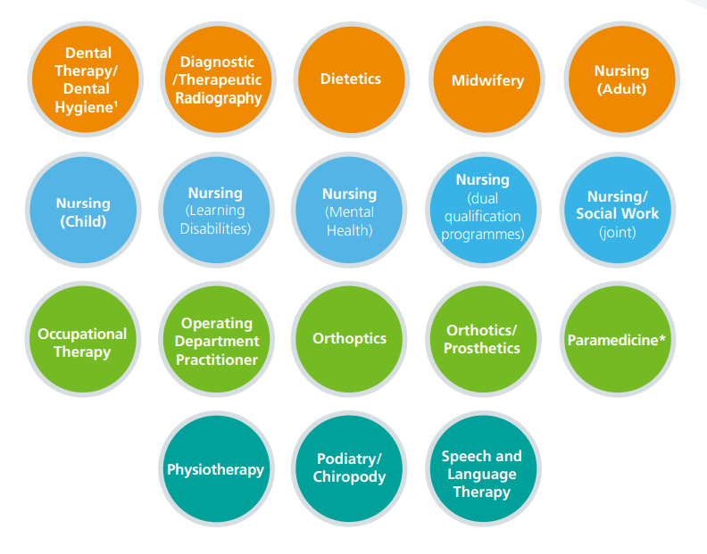
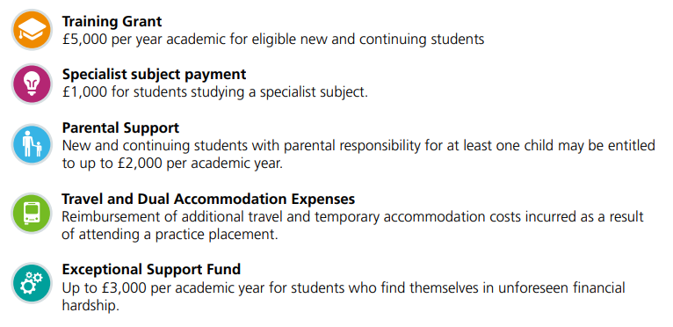
STUDENT FINANCE 2022/23
SOURCES OF EXTRA SUPPORT FOR STUDENTS
Other Key Points
Previous Study Exemption for 2nd degree (if NHS)
Maximum NHS and SFE funding available
Applications SFE usually Jan/Feb
Applications NHS usually April
Students eligible for the long course loan
(Students must be eligible for tuition fees and maintenance support in each AY to be able to access NHS LSF)
Visit NHS BSA / Student Services for more information

Slide 16
STUDENT FINANCE 2022/23
THE STUDENT FINANCE PACKAGE
MAINTENANCE
LOAN
EXTRA
SUPPORT
#2
APPLY
TUITION FEE
LOAN
#1

Slide 17
STUDENT FINANCE 2022/23
SOURCES OF EXTRA SUPPORT FOR STUDENTS
ADDITIONAL SUPPORT
There may also be extra financial support available for students who;
Have a disability, specific learning difficulty, long-term health condition or mental health condition
Have children or adult dependants
Study overseas as part of their UK based course or take a clinical placement
Study eligible Nursing, Midwifery or Allied Health Profession Courses
For more information on this support see www.gov.uk/student-finance/extra-help and www.nhsbsa.nhs.uk/student-services
Many universities and colleges also offer bursaries and scholarships, which can
depend on things like academic results, course choice or household income etc…
Notes:
Childcare Grant
Helps with childcare costs for dependent children aged under 15 at the beginning of the academic year (or under 17 if they have special educational needs) in registered or approved childcare. For more details on what childcare qualifies, visit www.gov.uk/studentfinance
Depending on their household income, the student can apply for 85% of their actual childcare. They can get this money for term times and holidays. Students won’t qualify for this grant if they, or their husband, wife or partner get the childcare part of the Working Tax Credit or childcare element of Universal Credit from HM Revenue & Customs.
Parents’ Learning Allowance
This allowance can help with course-related costs for students with dependent children.
The amount they can get depends on their household income; that is the income of the student’s husband, wife or partner (if they have one) and that of any dependants.
Adult Dependants’ Grant
The grant can help if a student has an adult who depends on them financially. This can’t be the student’s grown-up child or other adult who gets student finance.
There are some exceptions to eligible ‘other adult dependants’; students can’t claim for a spouse, civil partner or co-habiting partner who is also a student receiving a statutory award.
Disabled Students’ Allowances (DSAs) help pay for extra costs a student might have as a direct result of their disability, long-term health condition, mental-health condition or specific learning difficulty such as dyslexia or dyspraxia. DSAs are additional support available to students who may otherwise be prevented from attending a higher-education course because of a disability.
Key facts about DSAs:
• Available to undergraduates and postgraduates studying full-time or part-time (their part-time course must be at least 25% intensity of the full-time equivalent course)
• Doesn’t have to be repaid
• Doesn’t depend on household income: the amount students can get relates to their needs up to specified maximum amounts
• Doesn’t affect benefit entitlement. For example, other help students might get, like Disability Living Allowance, won’t be affected by DSAs
• Isn’t affected by a student’s age
• Isn’t affected by previous study
• Is paid directly to the supplier of the service or (in some circumstances) into the student’s bank account
Who can get DSAs?
DSAs are available to those who have:
• a mental-health condition, such as anxiety or depression;
• a specific learning difficulty, such as dyslexia or dyspraxia;
• a developmental disorder, such as autism or ADHD/ADD;
• a progressive medical condition such as Multiple Sclerosis, cancer or HIV;
• a sensory impairment which could affect the ability to see or hear;
• another physical or medical condition; or
• a long-term health condition.
Other conditions not mentioned on this list may be covered by DSAs
The applications for dependants grants and DSA can be triggered through the main student finance application process!!

Slide 18
STUDENT FINANCE 2022/23
POSTGRADUATE STUDY SFE FUNDING OPTIONS
ADDITIONAL SUPPORT
Eligible SFE students can apply for additional loan support if they want to progress
on to take postgraduate Master’s or Doctoral level courses:
A contribution loan of up to £11,836 for eligible Master’s courses
A contribution loan of up to £27,892 for eligible Doctoral courses
SFE Postgraduate Loans are paid directly to students as a contribution toward their costs rather than being split between tuition and maintenance
The repayment amount is calculated as 6% of income earned over the current threshold of £21,000 a year
The interest rate applied is fixed at Retail Prices Index +3%
i
For more information about SFE Postgraduate Loans go to:
www.gov.uk/funding-for-postgraduate-study or www.ucas.com/sfe
Notes:
A Postgraduate Master's Loan is funding to help with course and living costs whilst studying a postgraduate Master’s level course. It’s paid directly to the student and isn’t based on their income or the income of their household.
A Postgraduate Master’s Loan may affect any benefits they currently get.
They’ll be due to start repaying their loan the April after they finish or leave their course. Interest is charged on the loan from the day we make the first payment to the student until it is paid off in full or cancelled.
A Postgraduate Doctoral Loan helps towards course and living costs while studying a postgraduate Doctoral course. It’s paid directly to the student and isn’t based on their household income.
A Postgraduate Doctoral Loan may affect any benefits they currently get.
They'll be due to start repaying their loan the April after they finish or leave their course, or the April four years after they begin their course, whichever is earlier. Interest is charged on the loan from the day we make the first payment until it’s repaid in full or cancelled.
Students studying lower-level postgraduate courses, partial Doctoral courses or other Level 8 qualifications can’t get a Postgraduate Doctoral Loan.

Slide 19
STUDENT FINANCE OVERVIEW
APPLICATIONS
ACADEMIC YEAR 2022/23

Slide 20
STUDENT FINANCE APPLICATIONS
THREE STAGE PROCESS
SFE ASSESS
YOUR
APPLICATION
#2
APPLY
YOU GET
PAID!
YOU APPLY
ONLINE
#1

Slide 21
STUDENT FINANCE APPLICATIONS
KEY MESSAGES
Each year, too many students apply late for their finance and could have no way to
pay for courses or accommodation at the start of term...don’t let that be you!
Tips to help make sure you get paid on time;
You don’t need a confirmed place at university or college to apply
Apply with your preferred choice, you can change the details later if necessary
Make sure any evidence and information needed to support your application
is supplied ‘right first time’ both from you and your parents (or partner)
Read, understand and agree to the loan Terms and Conditions
i
The full-time SFE application service usually opens in the Spring with a
late May deadline: Go to studentfinance.campaign.gov.uk for details
Notes:
Other notes of importance for students;
Make a note of your account log-in details and keep them safe
Agree to share information from your application, this helps apply for many bursaries and some scholarships
Make sure any evidence and information needed to support your application is supplied first time (yours and your parent/partners’)
Submit your application even if there is a delay in getting income details from your parent/sponsor so some funding (Tuition and Maintenance Loan) will be available when you start your course
If SFE ask you to send any additional evidence or documents to support your application use recorded delivery!
Before starting the application, students should have the following to hand:
• Passport - SLC can check identity using valid UK passport details for most students
• University and course details – Remember apply with your first choice initially so your application can be assessed as soon as possible
• Bank account details
• National Insurance number
• Parent’s or partner’s National Insurance number and income details

Slide 22
STUDENT FINANCE APPLICATIONS
COMPLETING AN APPLICATION
Before starting an application, students should have the following to hand:
• Passport - SFE can check identity using valid UK passport details
• University and course details
UK bank account details and National Insurance number
The easiest way for parents or other sponsors to support an application is also
online through GOV.UK, providing their information including:
• National Insurance numbers
Household income information (Based on prior tax year)
Details of other child dependants
i
If their household income decreases by at least 15%, students can be
reassessed: www.gov.uk/apply-for-student-finance/change-an-application
Notes:
The easiest way for a student to prove their identity is to give us their valid UK passport number online, when they apply. We can then check and confirm their identity without them having to actually send us their passport. If a student doesn’t have a valid UK passport they’ll need to send us their original *birth or *adoption certificate, along with a Birth/Adoption Certificate Declaration Form.
This is available from www.gov.uk
If the student is a non-UK passport holder, they’ll need to send us their *valid non-UK passport and any original *supporting letters from the UK Border Agency explaining the student’s residency status. *These must be original documents, not photocopies. We’ll return them once we’ve confirmed their identity and checked they’re eligible.
If there is more than one dependant child in the same household, a standard allowance of £1,130 is deducted from the household income for each of these additional dependants. If there is more than one student from the same household in higher education (depending on household income) a further reduction may be possible through applying split contributions (expected parental contribution to a students maintenance costs)
For example, in a household with two students and a household contribution of £500, this would be divided between the two students. Where students in the same household fall under different student finance regulations, their household contribution would be calculated according to the regulations which apply to their individual circumstances. The household contribution is then divided by the number of students in that household.
A full chart of expected contributions based on household income can be found on in the policy documents on practitioners.slc.co.uk.

Slide 23
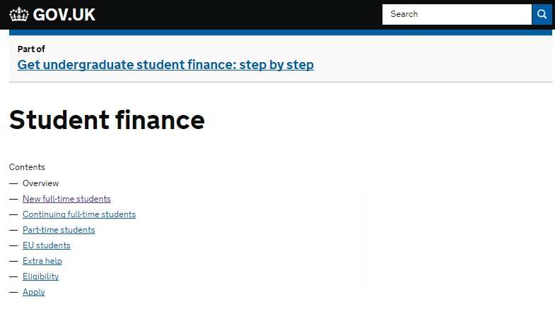






STUDENT FINANCE APPLICATIONS
GOV.UK/STUDENTFINANCE AND SFE ONLINE
More information about student finance can be found on GOV.UK and across the
SFE social media channels:
www.thestudentroom.co.uk/studentfinance
www.facebook.com/SFEngland
www.twitter.com/SF_England
www.ucas.com/sfe
www.youtube.com/SFEFILM

Slide 24
STUDENT FINANCE OVERVIEW
REPAYMENT

Slide 25
STUDENT LOAN REPAYMENT
THREE THINGS TO KNOW
THE
FIGURES
#2
APPLY
THE
INTEREST
THE
FACTS
#1

Slide 26
STUDENT LOAN REPAYMENT
INCOME CONTINGENT PLAN 2 STUDENT LOAN OVERVIEW
Some key facts about how student loan repayments work include;
You won’t have to make repayments until your income is over a set threshold (£27,295* a year, or £2,274 a month or £524 a week, until April 6th 2022)
If you study a full-time course, you will be due to start repaying from the April
after completing your course or leaving/withdrawing from higher education
You’ll repay 9% of any income earned over the threshold and if employed in
the UK, the deductions will be made from your pay through the tax system
If your income falls below the threshold at any time your repayments will stop
Any outstanding balance will be written off 30 years after entering repayment

Slide 27
STUDENT LOAN REPAYMENT
PLAN 2 STUDENT LOAN – THE FIGURES FROM APRIL 2021
Income each year before tax | 9% will be deducted from | Monthly Repayment (Approx)
£27,295 | £0 | £0
£35,000 | £7,705 | £57
£40,000 | £12,705 | £95
£45,000 | £17,055 | £132
£50,000 | £22,705 | £170
9% Deducted from?
Income
£30,000
£2,705
£20
Monthly
Repayment?
i
If you move or work overseas you will need to repay 9% of your earnings over the repayment threshold for the country you are living in

Slide 28
STUDENT LOAN REPAYMENT
PLAN 2 STUDENT LOAN – THE INTEREST
Interest on a student loan will start being added as soon as the first payments are
made and the rate applied will vary:
While in study until entering repayment, interest will be applied at RPI +3%
RPI is Retail Prices Index and the rate for student loans is set annually, using
the figure from March which is applied in September (1.5% until Sept 2022)
When you enter repayment, the interest rates will be linked to what you earn,
from RPI only to RPI +3%*
You will be able to check your loan balance and keep SLC updated with any changes to your circumstances using our Online Repayment Service
See www.gov.uk/repaying-your-student-loan for more information
i
*Thresholds from April 2021: Income under £27,295 = RPI Only, then on
a sliding scale until earning over £49,130 = RPI +3% (4.5%)
Notes:
Part-time RPI
While studying on a course until whichever comes first of:
the April after graduating or leaving a course; or
The April after the fourth anniversary of the start of a course - RPI + 3%
From the April after graduating or leaving a course, or after the fourth anniversary of the start of a course - RPI

Slide 29
STUDENT FINANCE OVERVIEW
BUDGETING AND KEY MESSAGES

Slide 30
BUDGETING AND KEY MESSAGES
CONSIDER THE COSTS
It’s important to think about the costs you are likely to face while at uni and how to
manage your money:
Remember, you’ll get a maintenance support payment each term and you’ll need
to pay for things like...
books and other essential study or course materials
accommodation, phone, internet, sports, social activities, food and drink
There might also be costs you may not have thought of yet, such as insurance or
a TV Licence, so planning a budget can help:
www.savethestudent.org/money/student-budgeting/student-budget-calculators
i
Could you balance study and work? Many students will work part-time alongside their study or during the holidays to supplement their income

Slide 31
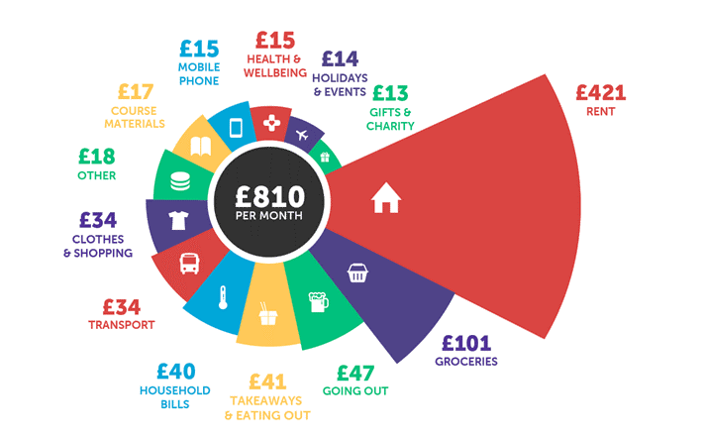
BUDGETING AND KEY MESSAGES
CONSIDER THE COSTS
Students across the UK spend an average of £810 each month, but on what?
Figures from Savethestudent.org Student Money Survey
Notes:
https://www.savethestudent.org/money/student-money-survey-2020.html

Slide 32
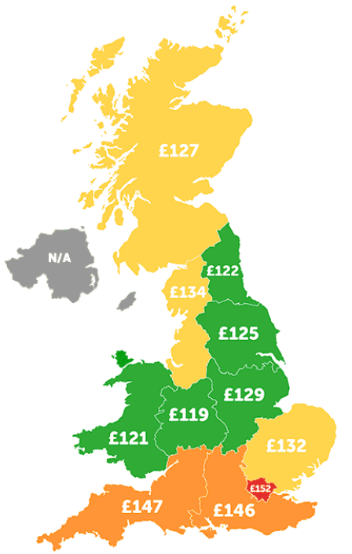
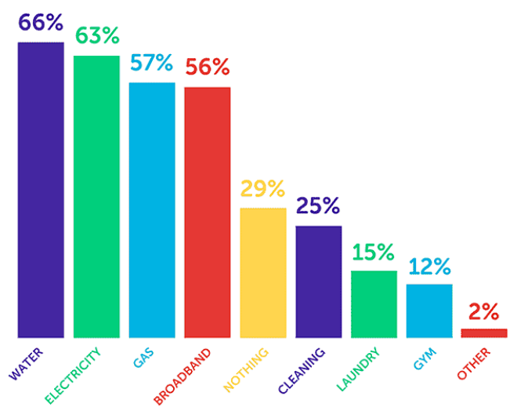
BUDGETING AND KEY MESSAGES
CONSIDER THE COSTS
The average student rent is £146 a week but how does this compare in different
areas of the UK and what services might be included in that price?
£152
Figures from Savethestudent.org Accommodation Survey
Notes:
As would be expected, London has the highest average student rent in the UK. However, rent in the South East and South West is not far behind. In the case of Northern Ireland, there wasn't sufficient data to provide a reliable figure.
National Student Accommodation Survey 2021 – Results - Save the Student

Slide 33
BUDGETING AND KEY MESSAGES
THREE POINTS TO REMEMBER
There is a lot of information available on student finance, from applying to repayment,
but it is vital to understand what it will mean to YOU and remember three key points...
#1
RESEARCH
Research ALL the SUPPORT available to you
Make THE RIGHT university or college choice
#2
#2
APPLY
Apply ONLINE & ON TIME
#2
APPLY
#3
#1
You DON’T need to WAIT for confirmed offers
#1
Not until you EARN OVER the set threshold
#3
REPAY
Based on WHAT YOU EARN not what you owe

Slide 34

QUESTIONS OR COMMENTS
NOW IT’S YOUR TURN

Slide 35

For further information on student finance,
applications and repayment
www.gov.uk/studentfinance
For a range of helpful tools and guidance,
visit the SFE student finance zone
www.thestudentroom.co.uk/studentfinance

